Slide 1
Unsupervised ML - Clustering
Premanand S

Slide 2
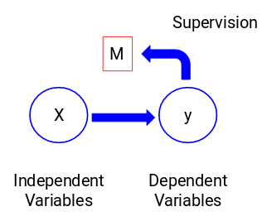
Supervised ML
The target variable is dependent on X and hence it is also called a dependent variable.
We train our model using the independent variables in the supervision of the target variable and hence the name supervised learning.

Slide 3
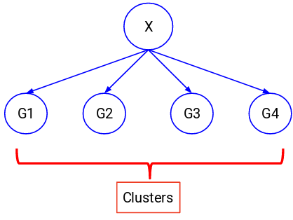
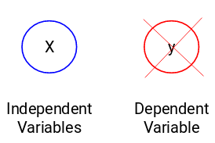
Unsupervised ML
There might be situations when we do not have any target variable to predict.
Such problems, without any explicit target variable, are known as unsupervised learning problems.
We only have the independent variables and no target/dependent variable in these problems.

Slide 4
K means clustering

Slide 5
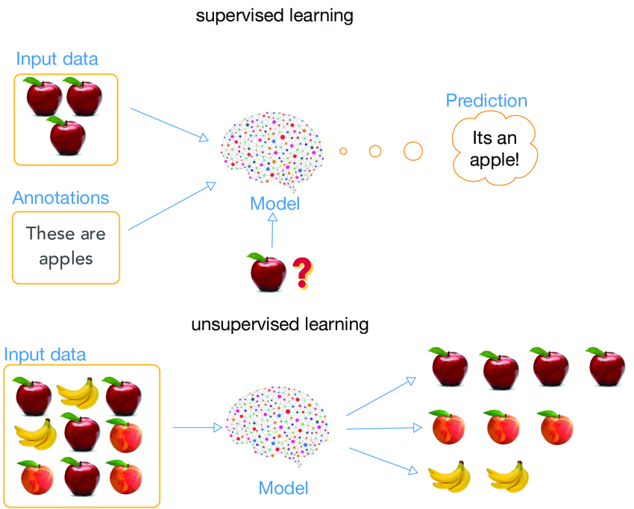
Supervised vs Unsupervised ML

Slide 6

Intuition - Clustering

Slide 7
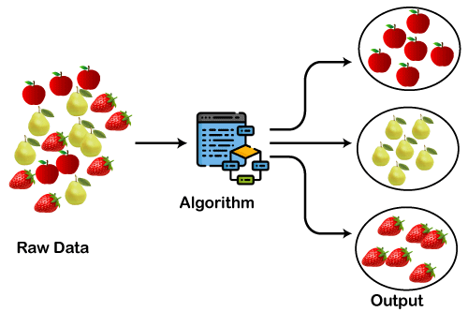
Clustering

Slide 8
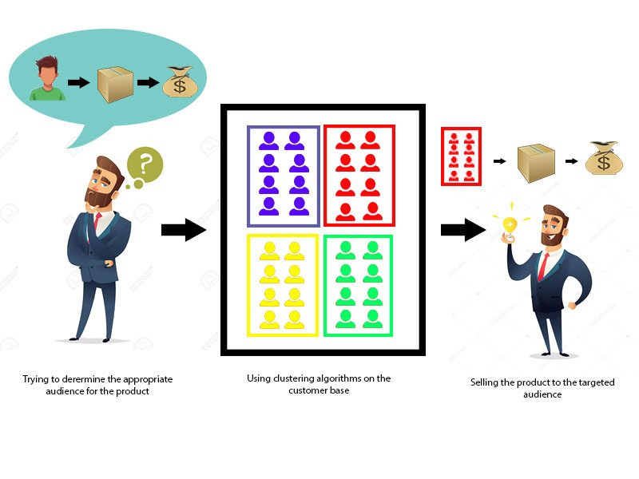
Clustering

Slide 9

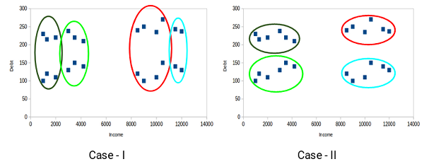
Properties of KMC
All the data points in a cluster should be similar to each other
The data points from different clusters should be as different as possible.

Slide 10
Application
Customer segmentation
Document clustering
Image segmentation
Recommender system

Slide 11
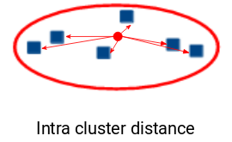
Inertia
Inertia actually calculates the sum of distances of all the points within a cluster from the centroid of that cluster
Euclidean or Manhattan distance
We calculate this for all the clusters; the final inertial value is the sum of all these distances. This distance within the clusters is known as intracluster distance.
Inertia gives us the sum of intracluster distances

Slide 12
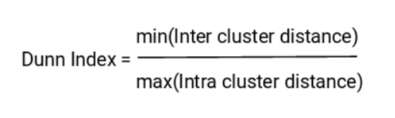
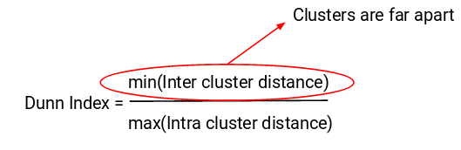
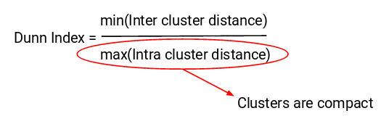
Dunn index
Dunn index also takes into account the distance between two clusters. This distance between the centroids of two different clusters is known as inter-cluster distance

Slide 13
Silhouette score
The Silhouette score is a metric used to measure the quality of clusters in a clustering algorithm like K-means. It provides a value between -1 and 1.
A high Silhouette score (close to 1) indicates that the data points within a cluster are close to each other and well-separated from other clusters. This is a sign of a good clustering.
A Silhouette score close to 0 suggests overlapping clusters or that data points are on or very close to the decision boundary between two neighboring clusters.
A negative Silhouette score (less than 0) indicates that data points might have been assigned to the wrong clusters.

Slide 14
How K means clustering works?
First we need to decide how many clusters we need ?
For each cluster we need to randomly placed centroid
K means will assign each of the data points to the closet centroid
We need to calculate centre of gravity or centre of mass for each cluster (need to take all X and Y coordinates and take average – that gives position of CoM – new centroid now)
We again repeat the same process, CoM, now the cluster also will keep on change
Until the value doesn’t change

Slide 15
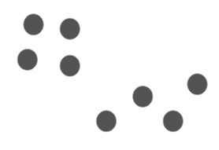
We have these 8 points, and we want to apply k-means to create clusters for these points. Here’s how we can do it.

Slide 16
Choose the number of clusters k
The first step in k-means is to pick the number of clusters, k.

Slide 17
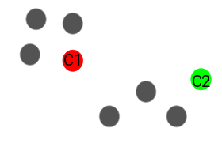
Next, we randomly select the centroid for each cluster. Let’s say we want to have 2 clusters, so k is equal to 2 here. We then randomly select the centroid

Slide 18
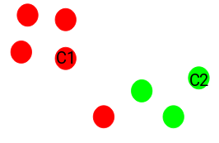
Assign all the points to the closest cluster centroid
Here you can see that the points closer to the red point are assigned to the red cluster, whereas the points closer to the green point are assigned to the green cluster.

Slide 19
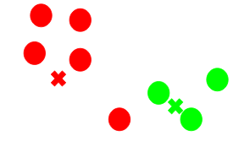
Recompute the centroids of newly formed clusters - CoM

Slide 20
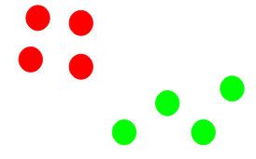
Repeat the previous steps until we don’t find any change

Slide 21
Stopping Criteria for K-Means Clustering
Centroids of newly formed clusters do not change
Points remain in the same cluster
Maximum number of iterations is reached

Slide 22
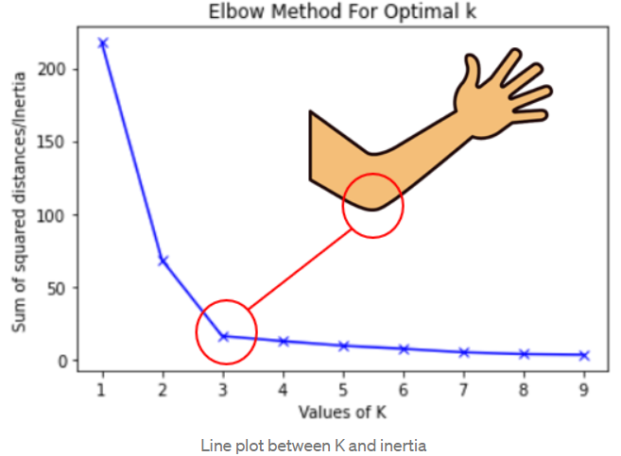
Elbow method?
Marbles
Try Different Numbers of Clusters (2,3,4 …)
Measuring Cluster Quality (Same member)
The Elbow Point (When you have too few clusters, the marbles are scattered all over, and when you have too many clusters, they're too cramped) – Bend your elbow

Slide 23

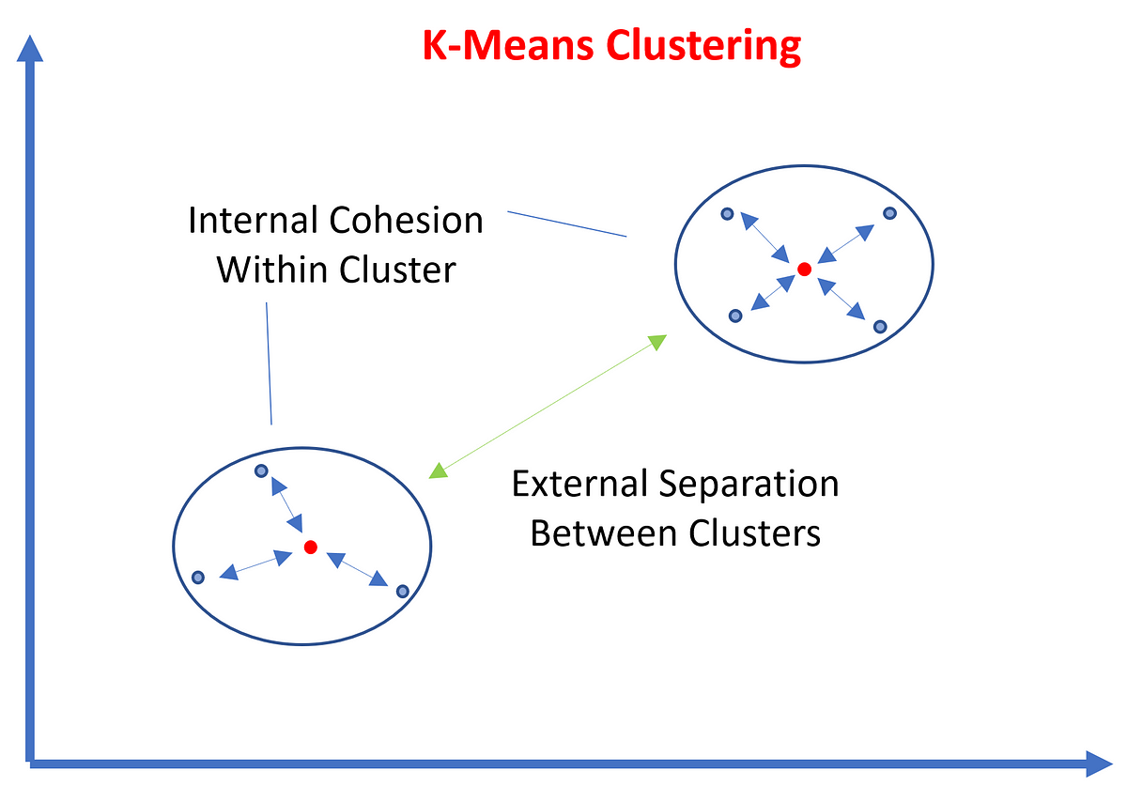
Elbow method
Within cluster sum of squares (WCSS)
Creating clusters
Measuring distance
Squaring and summing
Evaluating clusters (wcss is low (better and more tightly-packed clusters) means same colours)

Slide 24
K means ++
K-means++ is an improved initialization method for the K-means clustering algorithm.
It's designed to help K-means converge faster and produce better clustering
Random initialization trap
Imagine you want to group a bunch of points (data) into clusters, but you don't know where to start.
K-means++ helps you find good initial positions (centroids) for the clusters.
Selecting 1st centroid
Finding subsequent centroid
Repeat until all centroids are chosen
K-means++ ensures that your initial centroids are well-distributed across your data, making it less likely for K-means to get stuck in a poor solution or converge slowly.
This helps the K-means algorithm work more effectively and often leads to better clustering.

